Slide 1
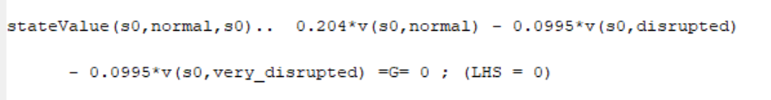
Question a
Explanation of Objective
stateValue(s,i,sp)$(abs(ord(sp)-ord(s))le lag)..v(s,i)-b*sum(j,pr(i,j)*v(sp,j))=g=decision_profit(s,i,sp);
objective.. z =e= sum((s,i),v(s,i));
Explanation of Output
stateValue(s0,normal,s0).. 0.204*v(s0,normal) - 0.0995*v(s0,disrupted) - 0.0995*v(s0,very_disrupted) =G= 0 ; (LHS = 0)
This means that at state 0 to go to state 0 again, (you buy nothing and sell nothing, no holding cost) hence profit is nothing and the LHS = 0
‘..’ Means the equation will commence
Explanation of Output
stateValue(s0,normal,s1).. v(s0,normal) - 0.796*v(s1,normal) - 0.0995*v(s1,disrupted) - 0.0995*v(s1,very_disrupted) =G= -4002 ; (LHS = 0)
This means that at state 0 to go to state 1 (1 means inventory = 100 kbbl), i.e. speculator must buy 100 kbbl

Slide 2
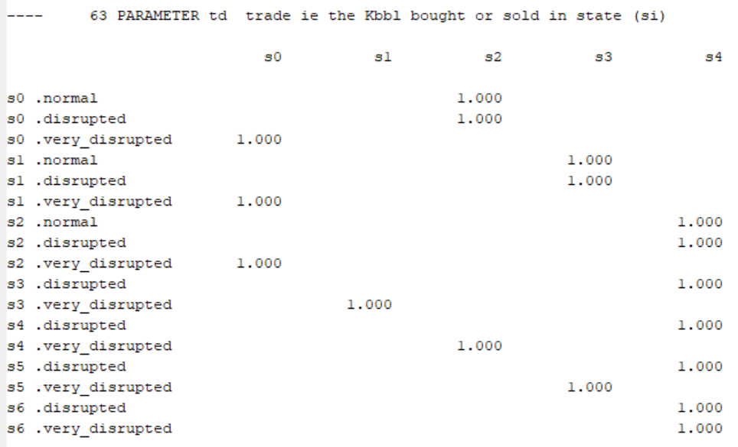
Question bi
Identify the optimal policy
The above table shows the optimal policy, the 1.00s indicate the action to pursue
For example, referring to the blue box, during a very disrupted state with the inventory = 200 kbbl, the optimal course of action is to sell all and return to state of inventory = 0 kbbl

Slide 3
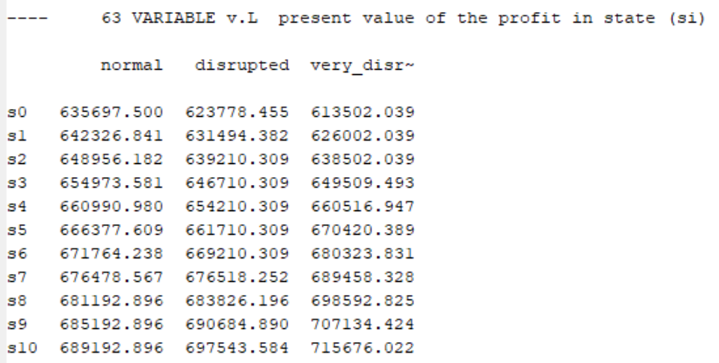
Question bii
Compute the expected profit
The above table shows the present value of profit given various states of inventory and market
For example, referring to the blue box, at time period s, during a normal market conditions if the state of inventory is 400 kbbl, the present value will be 660990

Slide 4
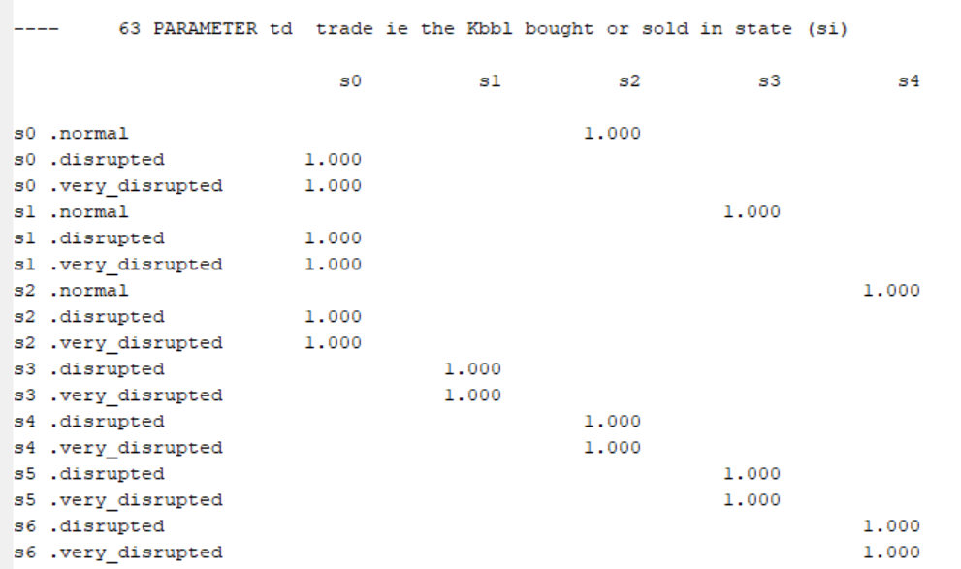
Question ci
How would optimal policy change if discount factor was 90%
Discount Factor .995
Discount Factor .9
The lower the discount factor, the greater the tendency to keep to lower inventory levels as seen in the red cluster

Slide 5
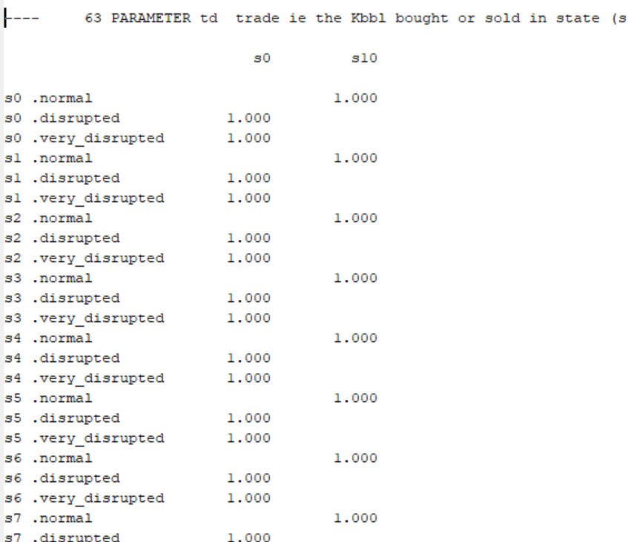
Question cii
It becomes an “all or nothing” binary decision

Slide 6
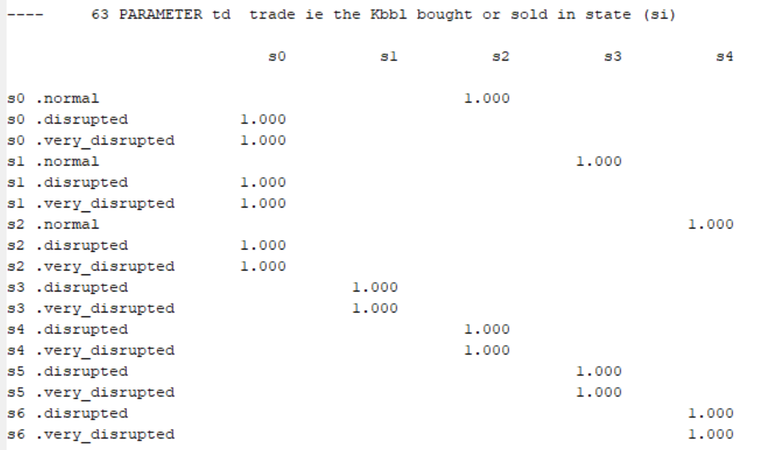
Question ciii
Discount Factor .9, original transition matrix
Discount Factor .995, new transition matrix
It seem to have the same effect of changing the discount factor from .995 to .9 as discussed earlier in the presentation
This suggests that the increase in probability of remaining in the same state of 10% corresponds to an decrease in discount factor of about 0.1

Slide 7
Question d
Policy is more important to speculator success, by relaxing the policy, it led to drastic change to the optimal decision
If we look at the shadow prices we expect changes to such variables to be the highest

